Slide 1

Scope of Variables

Slide 2
A variable can have something called a ‘scope’. This refers to its accessibility.

Slide 3
A variable can be declared in one of two ways…
When it is accessible from all parts of a program
(ie. Anywhere!)
A GLOBAL Variable.
When it is accessible ONLY within a function/procedure.
A LOCAL Variable.

Slide 4
Look at the following PYTHON program:
name = ‘Mary Poppins’
print(name)
So far, we have been working with variables in this manner.
Note that I can call the variable name from ANYWHERE in the program…i.e. it is accessible from anywhere!
These declarations have usually been done at the start of our programs, and have been declared OUTSIDE of any functions.
These are referred to as GLOBAL variables.

Slide 5
Look at the following PYTHON program:
def Greeting():
name = 'Mary Poppins'
age = 200
address = 'Far Far away'
Notice that these variables have been declared inside a function.
This means, the variables are only accessible from within the fucntion.
Hence, we have declared LOCAL variables here.
If I typed print(name) outside of this function,
it would result in a compile error!

Slide 6
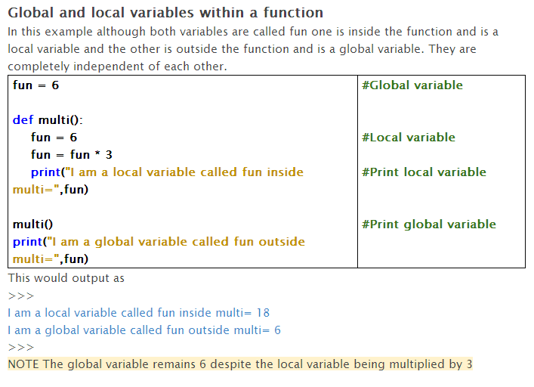

Slide 7
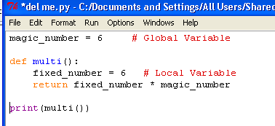
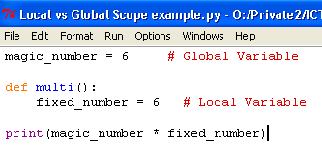
Result ?
36
Result ?
NameError: name 'fixed_number' is not defined

Slide 8
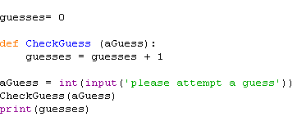
Look carefully at this code…
This simply asks the user for a number and then calls a function to increment each time the CheckGuess function is called.
Type this into Python & see what happens

Slide 9
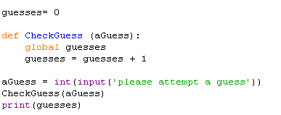
Look carefully at this code…
Insert global guesses
Note the use of the keyword global. This allows functio to modify/change the value of the global variable guesses!

